Slide 1
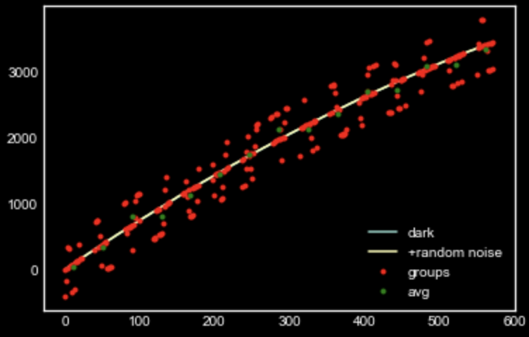
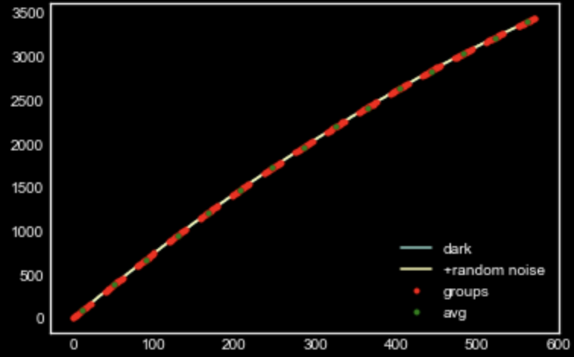
sample MAAC simulator with and without RTN Light current = 10.0, Dark current = 0.04, read noise = 9.0 and (ng=15, nf=16, nd=11)

Slide 2
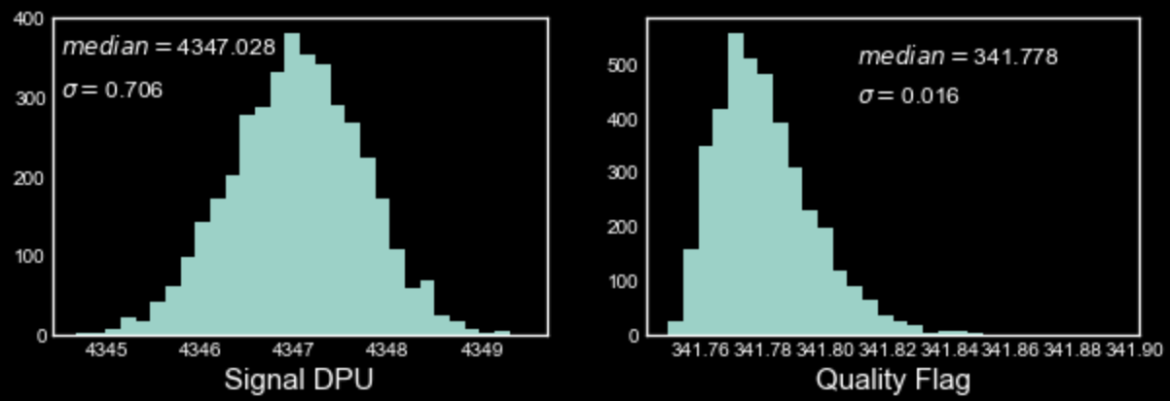
With NO NL and RTN, change in the QF and DPU signal

Slide 3
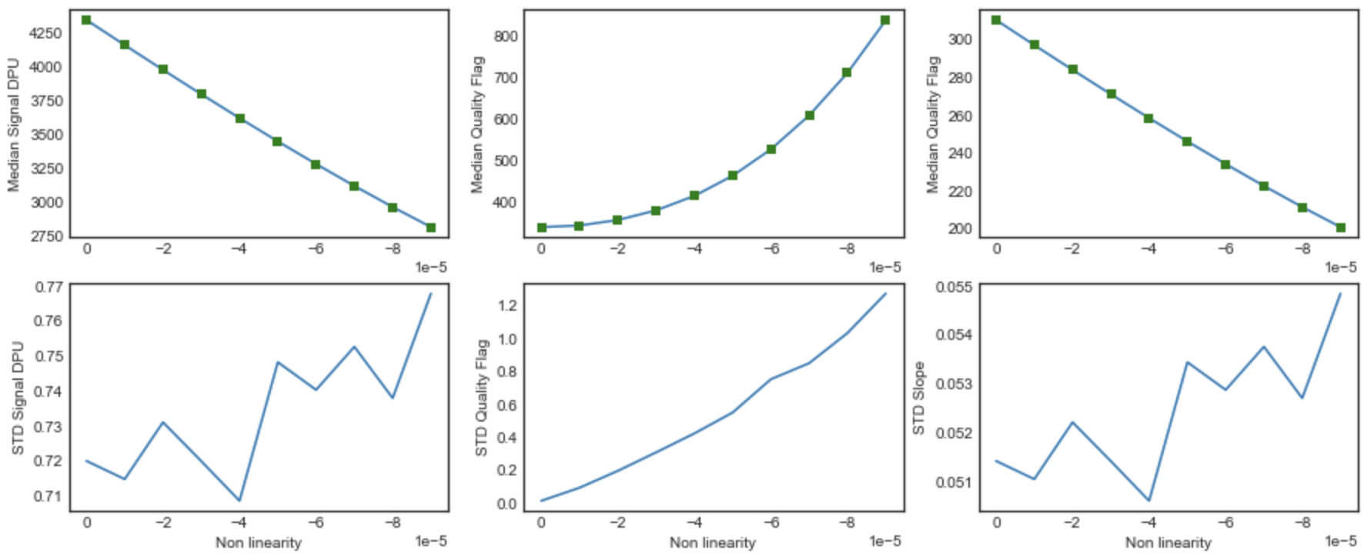
Change in signal and QF with Varying NL (no RTN)

Slide 4
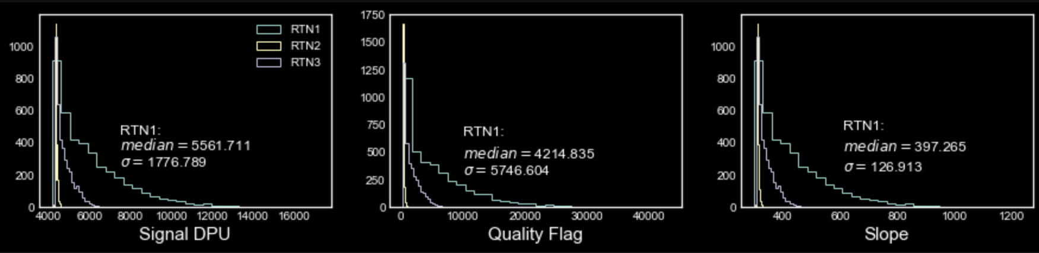
Change in Slope/signal and QF with RTN (no NL)
RTN rate and nelements are fixed here to 0.2 and 2000 respectively

Slide 5
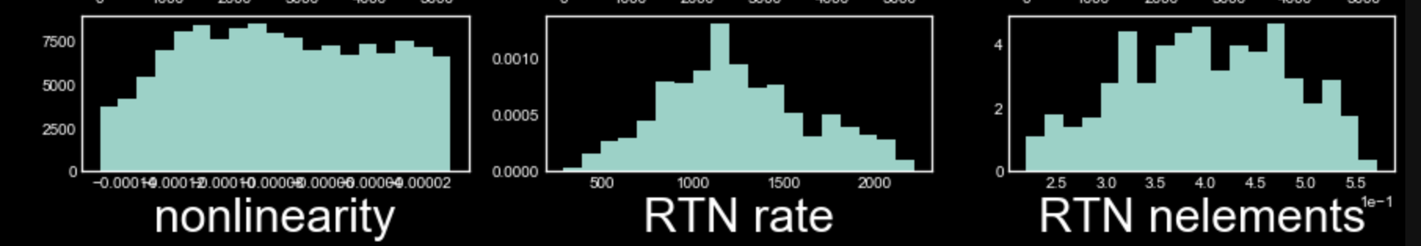
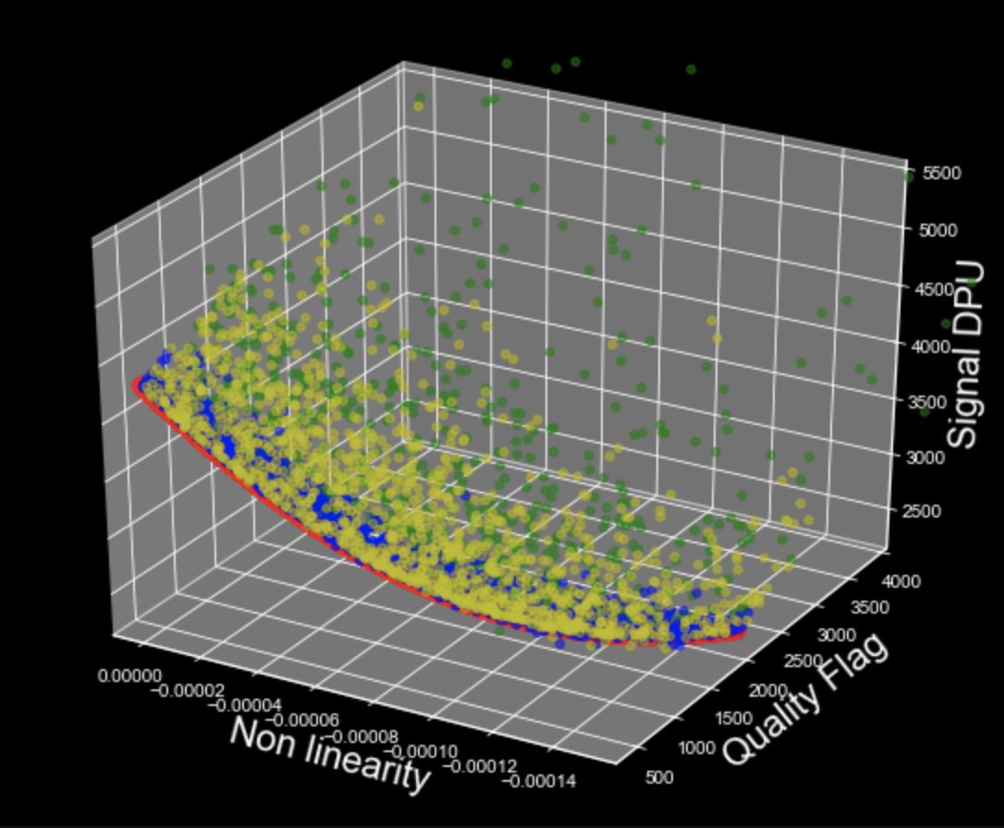
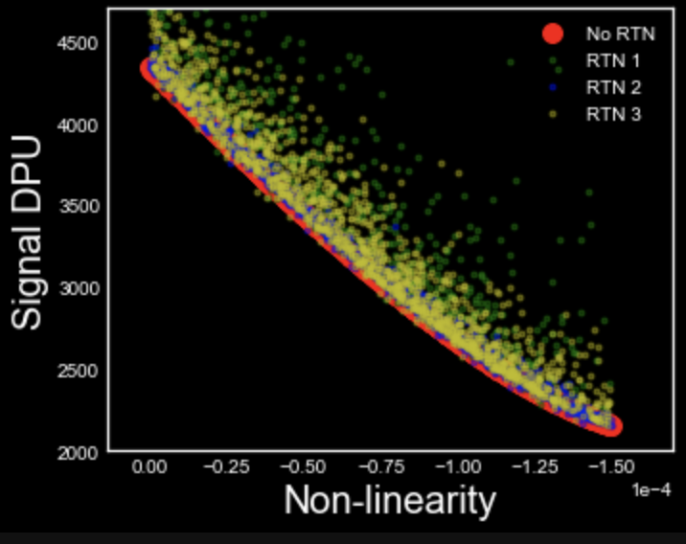
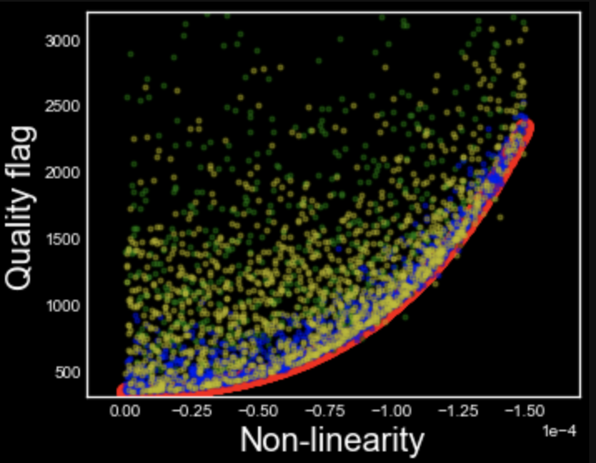
MCMC with 3 kinds of RTN and varying NL

Slide 6
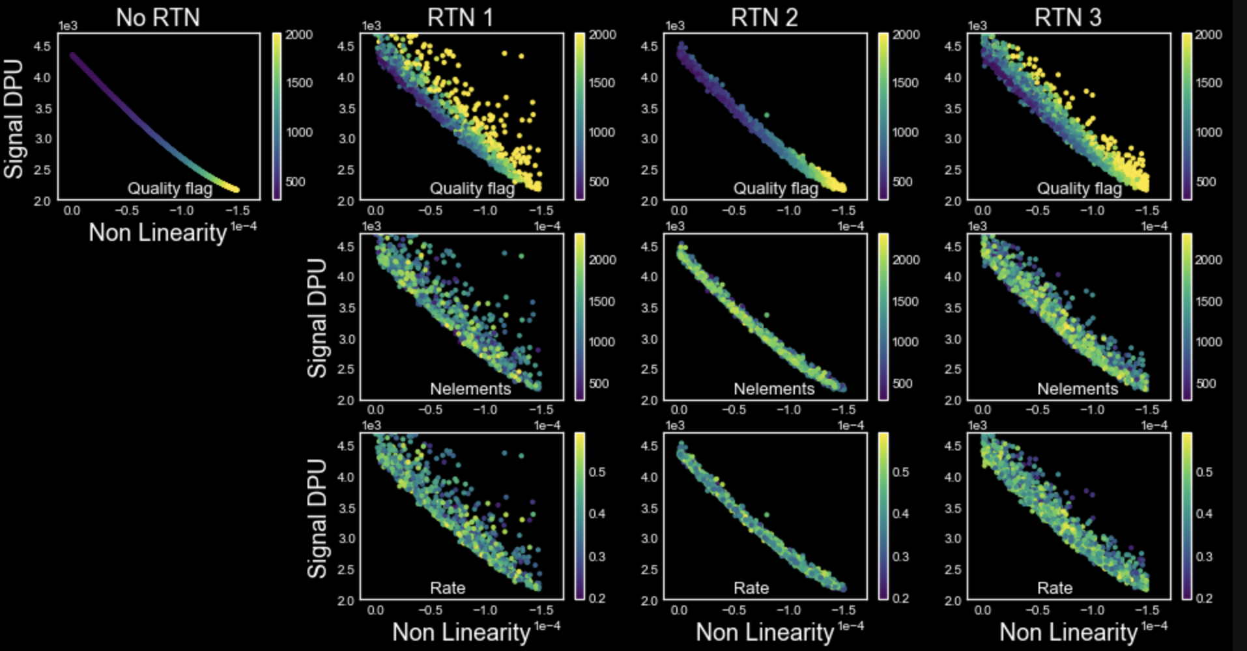

Slide 7
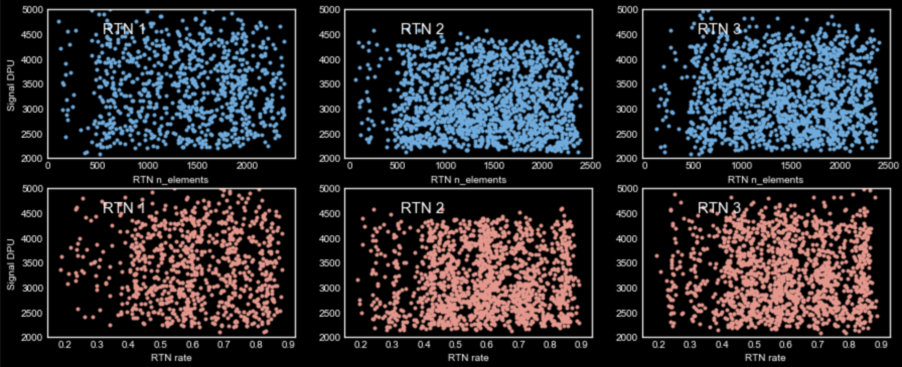
Almost no dependence of Signal on nelements and rate of RTN

Slide 8
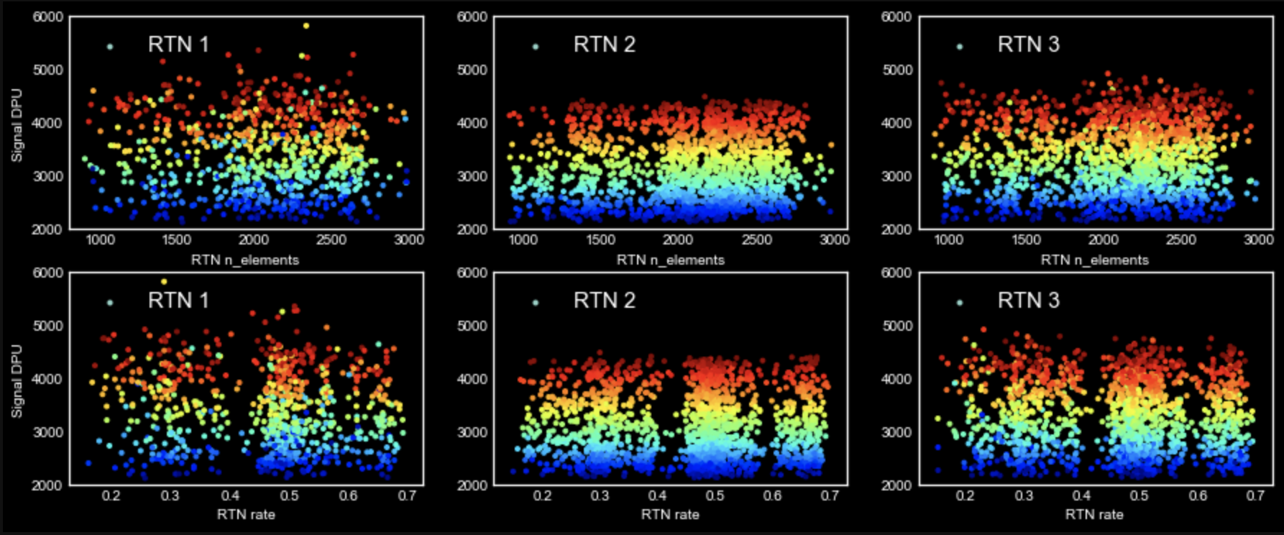
Color coded by NL

Slide 9
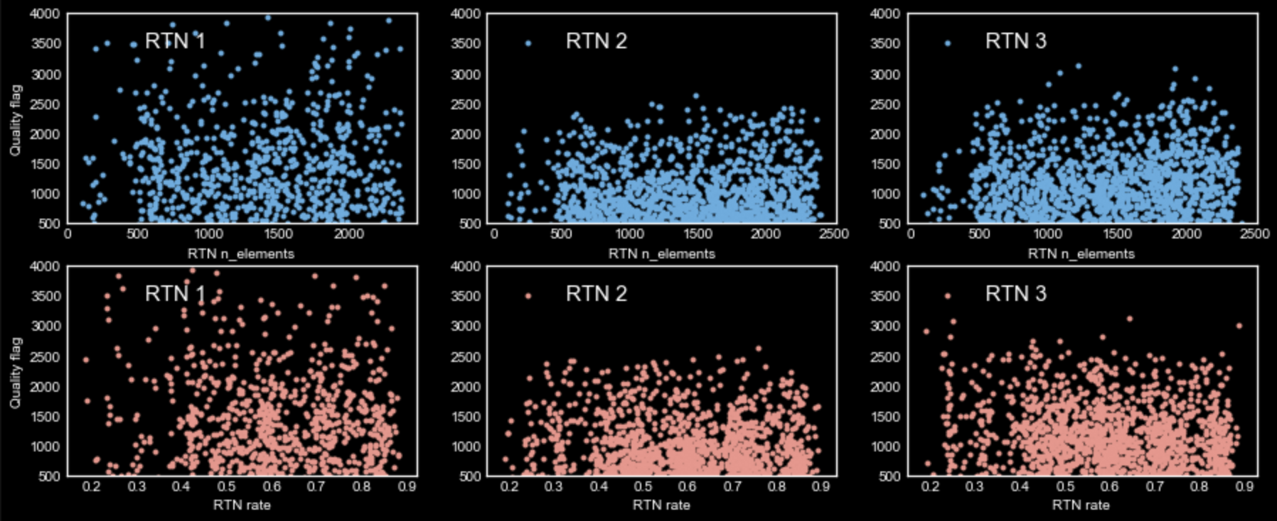
And no dependence of QF on nelements and rate of RTN

Slide 10
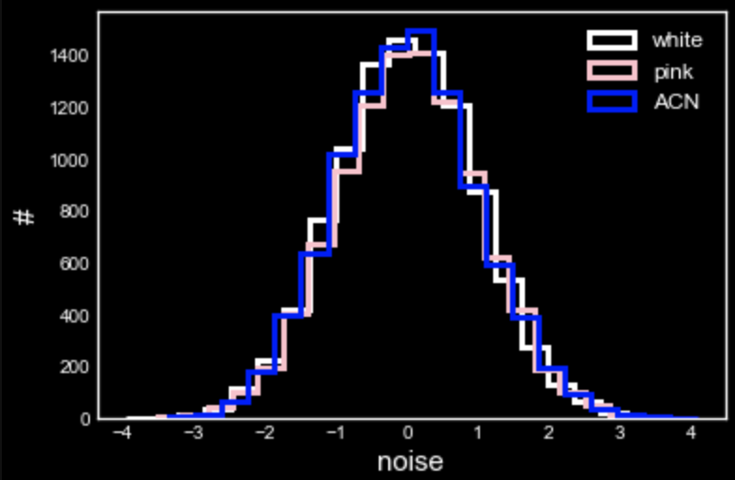
Bringing in more noise from noise generator package.
Many names but distributions are almost the same!
Maybe difference is only in the way they are added to images?
If that’s the case then adding these noise in pixel level rather than image might not be optimal?!
How can spatial correlations be taken into account at pixel level?

